Slide 1


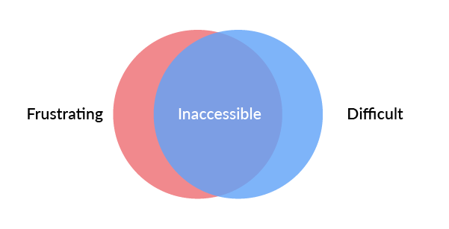
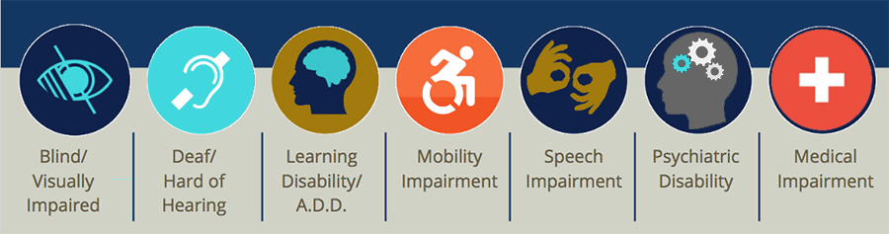
Accessibility
Accessibility is the practice of making your websites usable by as many people as possible .

Slide 2
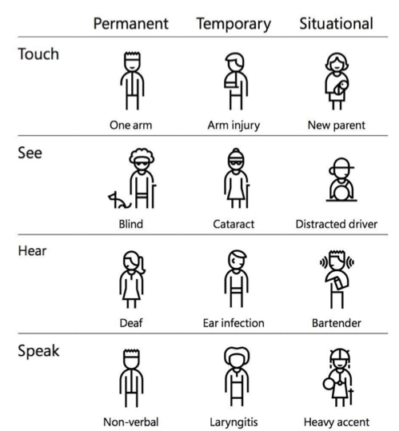
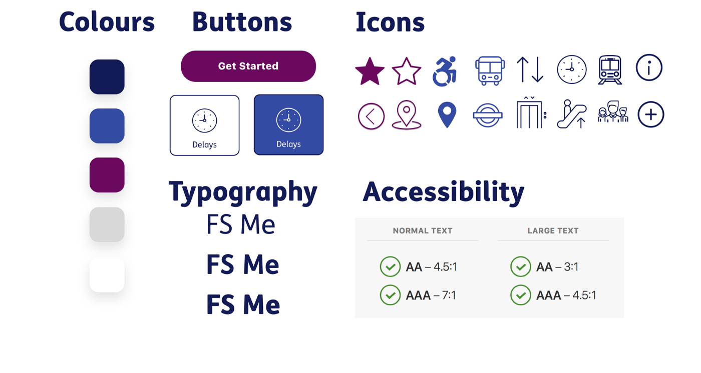

EXAMPLE OF ACCESSIBILITY

